Slide 1
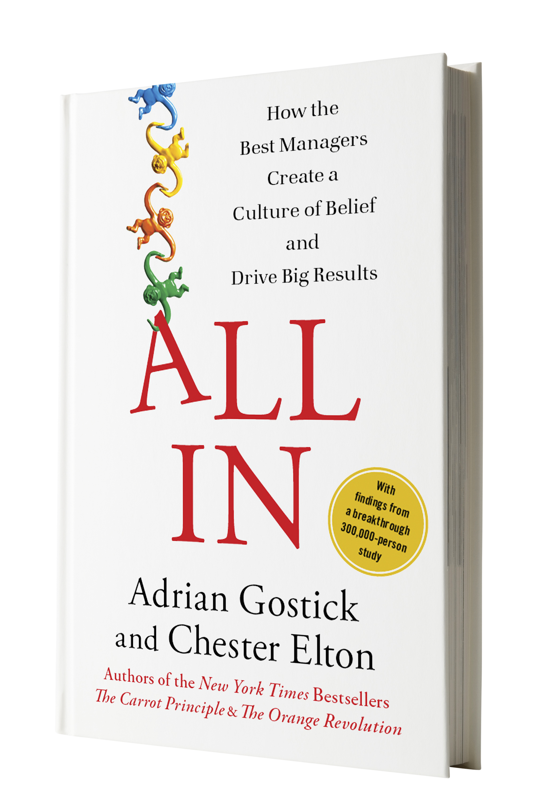
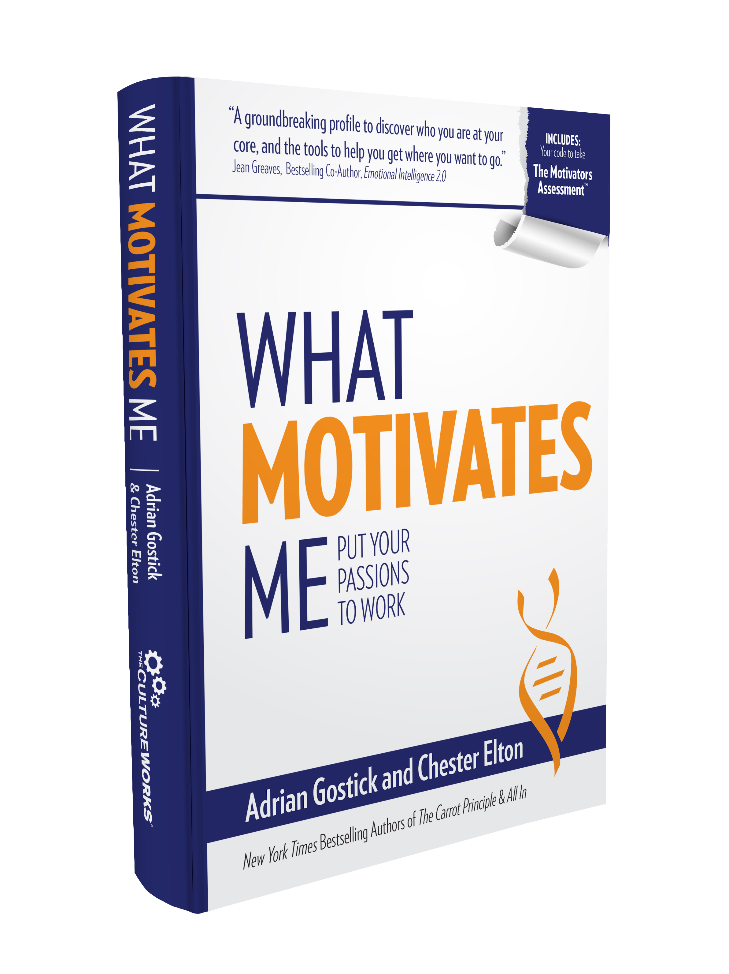

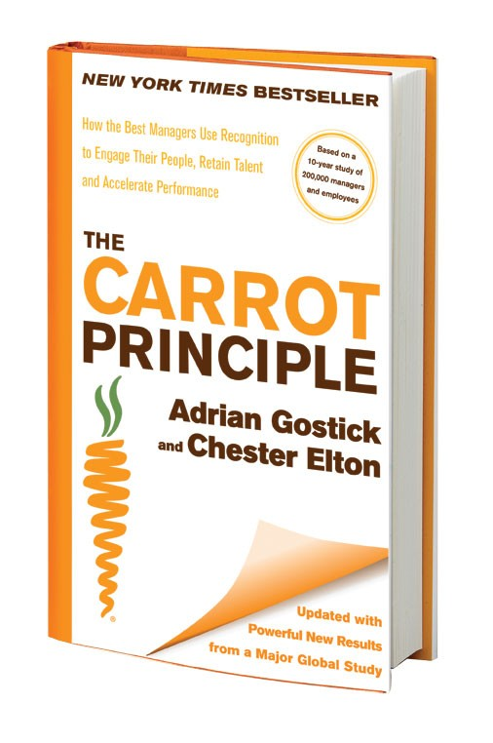
Let’s define our
Culture & drill down on Engagement
---------------------
with Adrian Gostick

Slide 2
What if we were as intentional about building people cultures in our teams as we are about medicine?

Slide 3
What we covered in our 2016 session

Slide 4
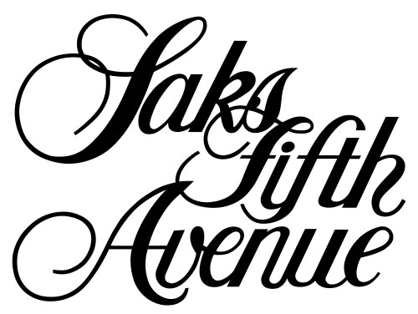
“Culture drives whatever you are trying to accomplish within an organization— innovation, execution, customer service, etc. And that drives results.”
Stephen Sadove, Chairman

Slide 5
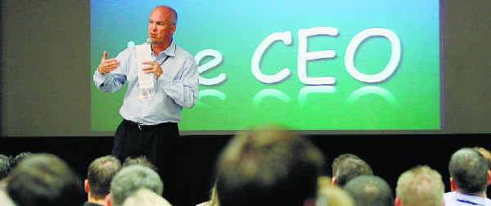
“If you don’t create a culture, a culture will create itself. And you can assume it’s the wrong culture.”
Bill Emerson, CEO, Quicken Loans
Fortune Best 100 Company to Work For 10 Years

Slide 6
YOU own the Michigan Medicine culture!
Congratulations

Slide 7
Aha #1
People in high-performance cultures are
engaged
enabled
energized

Slide 8
Aha #2
Leaders create culture

Slide 9
Aha #3
Seven-step road-map

Slide 10
The All In Road Map

Slide 11

Concern #3: Communication and feedback
Employees think managers could improve their communication skills and work on delivering effective feedback.
The person I report to is a good communicator | The person I report to gives me useful feedback
3.84 | 3.86
Notes:
Restructuring of the clinical enterprise – could be better with change management and communication about restructure.
We are beginning to work on improving feedback by working with compliance. Developing Feedback is a Gift campaign to encourage open dialogue between managers and staff versus use of anonymous compliance hotline.
As leaders, we NEED to engage with our employees.
Communication is critical if you want to build trust.
Restructuring of the clinical enterprise – could be better with change management and communication about restructure.
We are beginning to work on improving feedback by working with compliance. Developing Feedback is a Gift campaign to encourage open dialogue between managers and staff versus use of anonymous compliance hotline.

Slide 12

Concern #2: Recognition and development
Employees told us we need to get better at providing professional development opportunities & recognition.
I am satisfied with the recognition I receive for doing a good job
3.53
Notes:
While we have pockets where we do a good job, we can still do a better job at recognizing from an institutional perspective – not in silos.
In fact, the work around this has already begun.
An AMC Recognition Committee has already been stood up and includes employee representatives from across all three parts of our mission. This team is working together to revamp and streamline some of the existing programs, as well as create new and innovative programs to ensure recognition is and remains top of mind.

Slide 13
Concern #1: Trust and collaboration
Employees said we need to improve the level of trust and collaboration within & across departments.
Different work units work well together in this organization | There is a climate of trust within my work unit
3.57 | 3.58
Notes:
Health system initiatives or activities that may have influenced this measure:
Various VMI projects were underway, causing some disruption
Large departments critical to operations merging – MCIT/MSIS
Local initiatives like MiPART where new processes and work flows were defined:
Priority Discharge project requires different disciplines, for example case managers, MDs, nurses, pharmacists, social workers, and unit clerks, to now work dependently to discharge patients before 11 a.m. If someone doesn’t do their part, the result is like a domino effect.

Slide 14
Today: moving forward

Slide 15

Engaged people a key driver of culture at Michigan Medicine

Slide 16
Engagement’s Effect on KPIs
Top 25% vs. bottom 25%
Source: Gallup 8,000 teams

Slide 17
Gallup Engagement Study
94 hospitals; 130,000 employees
Hospitals with higher levels of engagement had significantly higher HCAHPS domain performance
HC units in top quartile in engagement vs. lowest = 41% difference in patient safety incidents
Engaged employees
  Their patients believed they received better care & more willing to recommend hospital
  Employees more satisfied with pay & benefits (stay)

Slide 18
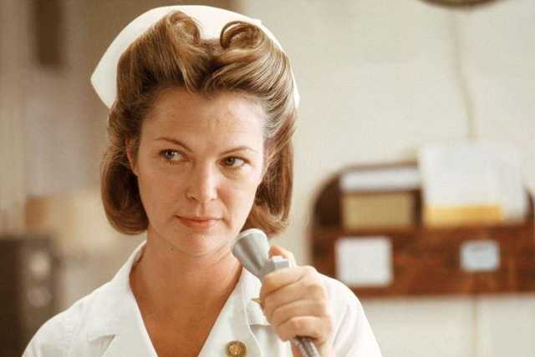
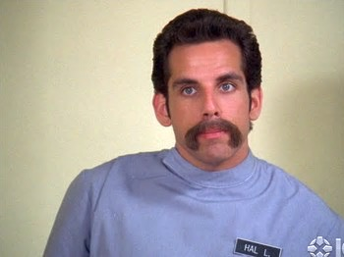
Engagement helps retain the best
Because the worst performers typically leave, right? Hardly. They aren’t going anywhere
Notes:
SAY: So what’s the cost of not having a motivating team environment? The number one cost is turnover. However, the good news is it’s the worst performers will typically leave when dissatisfied, right? Hardly. You have those people for life.
We all know it’s the best who are the first to go. Top performers have options; poor employees are just lucky to have a job. We need to keep our best by understanding what motivates them and aligning their work to match their passions.
Consider the results of a study by global management consulting firm McKinsey, conducted in the midst of the recent recession. The research noted the obvious, that companies around the world simply don’t have enough in their coffers to effectively motivate their entire workforce through monetary incentives alone, and that most companies have in fact had to cut back on financial-incentive programs during the long economic downturn.
It also found that employee morale has fallen at almost half of all companies it has surveyed over the last few years, just at a time when businesses most need their people to go above and beyond. Declining morale of course not only hurts employee retention but customer satisfaction.

Slide 19

The Dilemma
90% of executive leaders recognize the value of employee engagement
79% consider it to be a key driver of business performance
Only 24% believe their employees are engaged
Source: Towers Watson Global Workforce Study
32,000 people

Slide 20
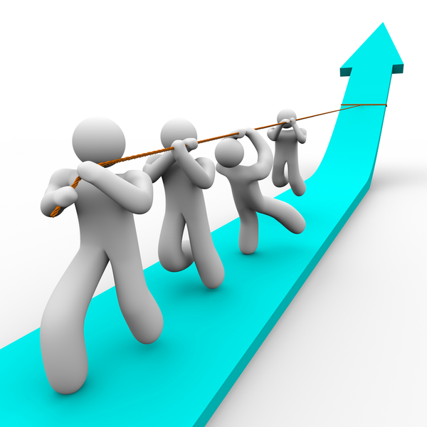
Engaged …
Show innovation and creativity
Take personal responsibility
Want to contribute to organization’s success
Emotionally bonded to core values
They care … don’t just do their jobs

Slide 21
USA Engagement top 3 drivers
* I believe I have the opportunity for personal development & growth in my organization. *My organization’s management is interested in the well-being of employees.
 | Overall | USA | China | Germany | India | Japan | Brazil | UAE | UK | Mex
Opportunity & Well-Being | 1 | 1 | 1 | 1 | 1 | 1 | 1 | 1 | 1 | 1
Trust | 2 |  |  | 2 | 2 | 3 | 2 | 3 | 3 | 2
Pride | 3 | 2 |  | 3 | 3 |  | 3 | 2 | 2 | 3
Recognition |  |  | 2 |  |  |  |  |  | 5
Accountability |  |  | 3
Alignment |  |  |  |  |  | 2
Goal-Setting |  | 3
Communication
* Management trusts the judgment of people at my level in my organization. * I trust my immediate supervisor.
* Senior management does a good job of clearly stating my organization’s goals. *My immediate supervisor plans our work around our most important goals.
Notes:
How these results vary by country. Notice right away. Opp and well being number one across the board.

Slide 22
What’s the Competition Doing?
We Are All Caregivers engagement initiative began in 2009.
Half-day learning sessions attended by all 43,000 caregivers.
Designed to enhance purpose & complement mission “Striving to be the world leader in patient experience, clinical outcomes, research & education."
"Compassion” & “integrity" added as new core values across the system that included quality, innovation, teamwork & service.

Slide 23
Recognition reinforces values
Team Members. Recognition supports importance of being a team member; teamwork a core value.
Innovators. Individuals recognized based on ideas/innovations (a core value), with greater rewards for innovations targeting improved patient experiences.

Slide 24
Caregiver Celebrations
Allows caregivers to recognize co-workers for work that supports values
Caregivers can nominate peers, managers, and direct reports for recognition
1 million+ awards given, worth $10 million+, in 5 years

Slide 26
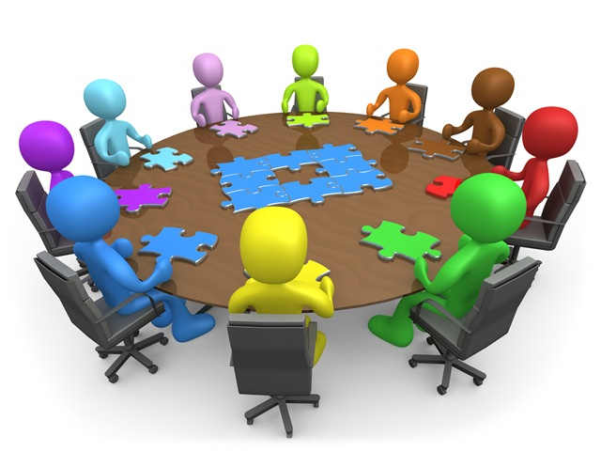
FINDING: Engagement starts at the top. Actions of senior leaders a key driver!

Slide 27
Exercise: Team Engagement Quiz
My people would strongly agree:
There are excellent opportunities to grow or learn new things around here.
My leader regularly talks to us about our futures/career progression in positive ways.
We are regularly recognized for our good work.
My boss understands what drives me & gives me assignments I find motivating.
We feel well-informed about organizational changes.
We are free to speak up & give feedback without fear of reprisal.
We feel our efforts make a difference every day.
We understand the bigger mission & values of our organization.

Slide 28
What are the next steps personally & as an organization we must take?

Slide 29
Now … Together …
Let’s begin to define an engaging new Michigan Medicine culture
Notes:
Here on one slide you can quickly talk through the evolution from CP to OR to AI. Hopefully your powerpoint can play the cool ‘float/fade’ effect of the books. If you have a higher rez photo of you two you could enlarge the size (that’s what she said.)

Slide 30
And identify the behaviors that will help achieve this culture
Notes:
Here on one slide you can quickly talk through the evolution from CP to OR to AI. Hopefully your powerpoint can play the cool ‘float/fade’ effect of the books. If you have a higher rez photo of you two you could enlarge the size (that’s what she said.)

Slide 31
Culture
noun 1. the product of group values & behaviors
Notes:
What is a team? Read, does that make sense?

Slide 32
One set of shared core values creates collaboration across a culture & dismantles silos
Notes:
What is a team? Read, does that make sense?

Slide 33




THE PATH TO ENGAGEMENT AT MM
Recognition & Development
Communication & Feedback
Trust & Collaboration

Slide 34



THE PATH TO ENGAGEMENT AT MM
Communication & Feedback
Recognition & Development
Trust & Collaboration

Slide 35
What is the second biggest cause of employee dissatisfaction in US workplaces?
Being‘left in the dark’

Slide 36
Concern #3: Communication & Feedback
Employees think managers could improve their communication skills & work on delivering effective feedback.
The person I report to is a good communicator | The person I report to gives me useful feedback
3.84 | 3.86
Notes:
Restructuring of the clinical enterprise – could be better with change management and communication about restructure.
We are beginning to work on improving feedback by working with compliance. Developing Feedback is a Gift campaign to encourage open dialogue between managers and staff versus use of anonymous compliance hotline.
As leaders, we NEED to engage with our employees.
Communication is critical if you want to build trust.
Restructuring of the clinical enterprise – could be better with change management and communication about restructure.
We are beginning to work on improving feedback by working with compliance. Developing Feedback is a Gift campaign to encourage open dialogue between managers and staff versus use of anonymous compliance hotline.

Slide 37

THE PATH TO ENGAGEMENT AT MM
Recognition & Development
Communication & Feedback
Trust & Collaboration

Slide 38
Concern #1: Trust & Collaboration
Employees said we need to improve the level of trust & collaboration within & across departments.
Different work units work well together in this organization | There is a climate of trust within my work unit
3.57 | 3.58
Notes:
Health system initiatives or activities that may have influenced this measure:
Various VMI projects were underway, causing some disruption
Large departments critical to operations merging – MCIT/MSIS
Local initiatives like MiPART where new processes and work flows were defined:
Priority Discharge project requires different disciplines, for example case managers, MDs, nurses, pharmacists, social workers, and unit clerks, to now work dependently to discharge patients before 11 a.m. If someone doesn’t do their part, the result is like a domino effect.

Slide 39
Leaders who foster trust
Create an environment of non-negotiable respect
Ensure people feel their opinions are valued
  Diligently & publicly seek diverse opinions (inclusive)
Negative or abusive behavior is swiftly addressed
Apply core values to every decision
Listen more than talk
Are Accessible
Notes:
SAY: So, I ask you a minute ago to think about a leader you worked for you didn’t trust. Now, I want you to think for a moment about your best manager ever, someone you did trust.
As a table, discuss for 4 minutes:
Why did you trust them?
Were you “kept in the loop?”
How did they communicate with you? (i.e., one-on-ones, team meetings, informal, lunches, etc.)?
<Allow them to discuss as a table for four minutes and then report their thoughts to the large group.>

Slide 40
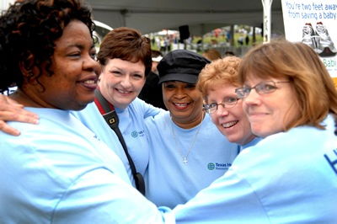
Transparency in health care drives collaboration
Among clinicians: No fear of giving suggestions, pointing out problems, or providing feedback
With patients: After an adverse event—clearly describing what happened & what’s being done to prevent it happening again
Among teams: Sharing best practices & applying lessons
Notes:
SAY: So, I ask you a minute ago to think about a leader you worked for you didn’t trust. Now, I want you to think for a moment about your best manager ever, someone you did trust.
As a table, discuss for 4 minutes:
Why did you trust them?
Were you “kept in the loop?”
How did they communicate with you? (i.e., one-on-ones, team meetings, informal, lunches, etc.)?
<Allow them to discuss as a table for four minutes and then report their thoughts to the large group.>

Slide 41
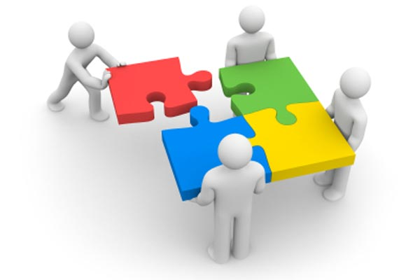
Collaborative Teams
Everyone feels safe to speak up and challenge traditional ways

Slide 42
Psychological Safety Gap Quiz
Identify gaps & brainstorm solutions
My team members would say they can ask questions without fear of looking stupid or incompetent.
We are respectfully critical of each other without acting negative.
Anyone can suggest innovative ideas without being perceived as disruptive.
Our patients (customers) feel safe to share their concerns with any team member.

Slide 43
Safe Place
Everyone can ask questions or make suggestions without fear of looking stupid or incompetent (there is no dumb idea)
We will be respectfully challenging of each other without acting negative.
Anyone can suggest innovative ideas without being perceived as disruptive.
No one laughs, no one criticizes.

Slide 44
Smart Debate
Challenge the position, not the person
The best idea wins
Present facts, not supposition
Support the decision
Seek counsel

Slide 45
From: “Nope, won’t fly.”
To: “That just might work.”

Slide 46
THE PATH TO ENGAGEMENT AT MM
Recognition & Development
Communication & Feedback
Trust & Collaboration

Slide 47
Collaborative Teams
Everyone feels safe to speak up and challenge traditional ways
Smart failures rewarded
Positive Radicals allowed a voice
Leaders help staff focus on mission of organization & why it’s important

Slide 48
Michigan Medicine Pediatric Cardiology
We turn patients’ and their families’ worst day into their best day.
Dr. John Charpie, Director

Slide 49
Top Driver of Trust in Health Care:
“My Voice is Heard”
Engagement scores increase 20-50%
Michigan Health & Hospital Association 2016 Survey
Notes:
SAY: So, I ask you a minute ago to think about a leader you worked for you didn’t trust. Now, I want you to think for a moment about your best manager ever, someone you did trust.
As a table, discuss for 4 minutes:
Why did you trust them?
Were you “kept in the loop?”
How did they communicate with you? (i.e., one-on-ones, team meetings, informal, lunches, etc.)?
<Allow them to discuss as a table for four minutes and then report their thoughts to the large group.>

Slide 50
THE PATH TO ENGAGEMENT AT MM
Recognition & Development
Communication & Feedback
Trust & Collaboration

Slide 51
Concern #2: Recognition & Development
Employees told us we need to get better at providing recognition & professional development opportunities.
I am satisfied with the recognition I receive for doing a good job
3.53
Notes:
While we have pockets where we do a good job, we can still do a better job at recognizing from an institutional perspective – not in silos.
In fact, the work around this has already begun.
An AMC Recognition Committee has already been stood up and includes employee representatives from across all three parts of our mission. This team is working together to revamp and streamline some of the existing programs, as well as create new and innovative programs to ensure recognition is and remains top of mind.

Slide 52
Development

Slide 53
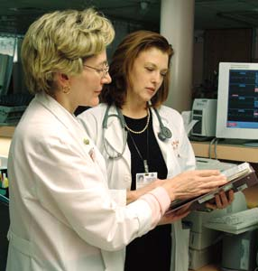
Managers develop people

Slide 54
Do your people feel coached as individuals?

Slide 55
What if…
What if you knew each team member’s motivators?

Slide 56
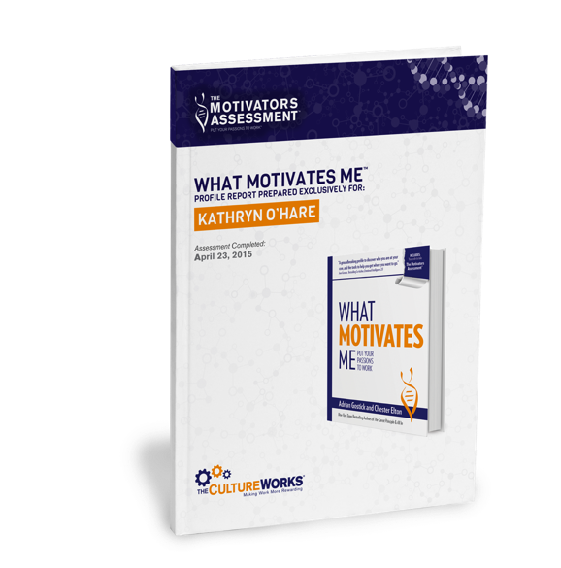
Motivators Assessment Profile
Notes:
SAY: Now the moment you’ve all been waiting for! Now that you are familiar with the meanings of Motivators and Identities, it’s time to unveil your Motivators Assessment Profile and look deeply into your Motivators and Identities. Don’t pull it out yet, we’ll get to that in just a moment.
We have printed off the first five pages of your profile for our exercise today, but the full profile is available online for download or reviewing and sharing online. Details on how to access your report are in your profile.

Slide 57
Identities
Notes:
SAY: As the researchers worked with the motivators, they noted that certain of the 23 seemed to be linked closely to others—for instance, don’t you think creativity and learning would be first cousins? You can probably guess about similar clusters that would emerge. They thought that if they could identify groupings of the motivators, they might point to a set of general types of individuals. We might see ourselves in these archetypes, or the people we work with.
From what’s called a “factor analysis,” five clusters of commonly related motivators emerged, showing that people who score high in certain motivators will also score higher with related motivators. For instance, if a person’s recognition motivation is very high, it’s very likely that their other reward drivers, money and prestige, will also be nearer the top of his or her list of motivators.
The five clusters of motivators are called Identities. They are, and we will define each in detail on the following slides.
The Achievers
The Builders
The Caregivers
The Reward-Driven
The Thinkers
Here’s a table and job aid <show job aid> that summarizes where the motivators appear in each identity.
<Note: While the factor analysis identified some identities with six motivators and some with three, through empirical weighting we are able to statistically balance the results on an individual’s Motivator Profile.>

Slide 58
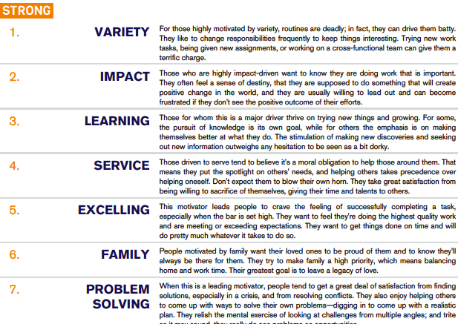

Motivators
Notes:
SAY: Here are your Motivators…Any motivator in your top seven is considered strong, the most important to you right now in your career. Those in the next seven are moderate. They may be significant at times, but they aren’t dominant in your thinking. Those remaining are in the neutral zone—they are not your passions at work.
Remember all the motivators from 1 to 23 are all positive concepts, and you may look at one of the lower scoring items and think, “But that idea is important to me!” What the results are showing is that that motivator may satisfy you or be a vehicle to achieve more important motivators, but it’s not a big driver in and of itself. It’s not why you get out of bed every day and go to work.
<NOTE: The Motivators are shared in rank order according to magnitude scores. Meaning, some motivators scores may have scored significantly higher than others in the ranking. Scores of magnitude are not shown in your report.>

Slide 59
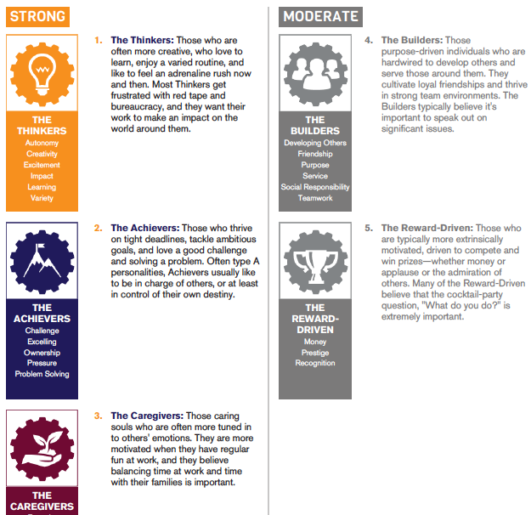
Identities
Who Are They?
Characteristics?
Where They Thrive
How to Enhance Your Value and Accomplish More
How to Address Blind Spots and Potential Conflicts
Notes:
SAY: Your profile will show you your top Identities, and give you some detail on each of the archetypes: Who Are They and Where They Thrive.
<NOTE: Identities are ranked based on motivator composite scores. Motivator scores of magnitude contribute to the composite score that determines the identity ranking. This could lead to scenarios where highest motivators (ranked by magnitude) seem a mismatch with highest identities (ranked by motivator composite score). Don’t let that concern you.>
Your report also offers 60 strategies to Enhance Your Value and accomplish more at work, and how to avoid blind spots and potential conflicts within your team.
These strategies will help you sculpt your work to do more of what you love and a little less of what frustrates you.

Slide 60

Aspirational Career Conversations
Length: 15-30 minutes
Cadence: Every month
Focus only on career development
Use an Individual Development Plan

Slide 61
Lack of career development
Now the #1 reason why employees leave
  A change from just a few years ago when pay topped the list
Chicago Tribune—2016 Data from CEB Global Survey

Slide 62
“Telling people how valuable they are is the cheapest thing on earth, and yet curiously hard.”
Dr. Carol Bradford

Slide 63
Recognition

Slide 64

Timely Recognition
How can you make sure desired behaviors and performance in your team members are reinforced in a timely manner?
Notes:
DO IN WORKBOOK: This leads us to our first commitment, take 3 min. and make a few notes on how you will make sure that desired behaviors and performance in your team members are reinforced in a timely manner.

Slide 65
Harvard Business Review
March 2013
5.6 : 1
Top performing teams gave each other 5.6 positive comments for each negative
1.9 : 1
0.36 : 1
LOW
MED
HIGH
Performance

Slide 66
“People may forget what you say or even what you do, but they never forget the way you make them feel.”
Maya Angelou
Notes:
SAY: The impact of a powerful presentation can be very strong indeed. Something to remember about any award presentation is that people may forget what you say or even what you do, but they will never forget the way you make them feel.

Slide 67
Praise Effort
Reward Results

Slide 68

Exercise: 360° Recognition Checkup
Action Plan: Develop Agility
I know how each of my people likes to be recognized. T F
I offer a ratio of at least 5 to 1 praise to criticism. T F
I don’t delay. I recognize great performances right away. T F
I reward behaviors that are tied to our core values. T F
I recognize each of my people at least once every 7 days. T F
I record specific behaviors for later award presentations. T F
I encourage and help employees recognize each other. T F
My people know what it takes to get recognized around here. T F
I use regular recognition to communicate what we value most. T F
I am always specific when I praise or recognize. T F
0-3: You need to work on this. 4-7: Good start. Keep working! 8-10: You are a champion!

Slide 69
THE PATH TO ENGAGEMENT AT MM
Recognition & Development
Communication & Feedback
Trust & Collaboration

